Slide 1
Module 6:
Association Rules & Sequential Patterns

Slide 2
Association rule mining
Proposed by Agrawal et al in 1993.
It is an important data mining model studied extensively by the database and data mining community.
Assume all data are categorical.
No good algorithm for numeric data.
Initially used for Market Basket Analysis to find how items purchased by customers are related.
Bread → Milk [sup = 5%, conf = 100%]
CS583, Bing Liu, UIC

Slide 3
The model: data
I = {i₁, i₂, …, i_{m}}: a set of items.
Transaction t :
  t a set of items, and t ⊆ I.
Transaction Database T: a set of transactions T = {t₁, t₂, …, t_{n}}.
CS583, Bing Liu, UIC

Slide 4
Transaction data: supermarket data
Market basket transactions:
  t1: {bread, cheese, milk}
  t2: {apple, eggs, salt, yogurt}
  … …
  tn: {biscuit, eggs, milk}
Concepts:
  An item: an item/article in a basket
  I: the set of all items sold in the store
  A transaction: items purchased in a basket; it may have TID (transaction ID)
  A transactional dataset: A set of transactions
CS583, Bing Liu, UIC

Slide 5
Transaction data: a set of documents
A text document data set. Each document is treated as a “bag” of keywords
doc1: Student, Teach, School
doc2: Student, School
doc3: Teach, School, City, Game
doc4: Baseball, Basketball
doc5: Basketball, Player, Spectator
doc6: Baseball, Coach, Game, Team
doc7: Basketball, Team, City, Game
CS583, Bing Liu, UIC

Slide 6
The model: rules
A transaction t contains X, a set of items (itemset) in I, if X ⊆ t.
An association rule is an implication of the form:
X → Y, where X, Y ⊂ I, and X ∩Y = ∅
An itemset is a set of items.
  E.g., X = {milk, bread, cereal} is an itemset.
A k-itemset is an itemset with k items.
  E.g., {milk, bread, cereal} is a 3-itemset
CS583, Bing Liu, UIC

Slide 7
Rule strength measures
Support: The rule holds with support sup in T (the transaction data set) if sup% of transactions contain X ∪ Y.
  sup = Pr(X ∪ Y).
Confidence: The rule holds in T with confidence conf if conf% of tranactions that contain X also contain Y.
  conf = Pr(Y | X)
An association rule is a pattern that states when X occurs, Y occurs with certain probability.
CS583, Bing Liu, UIC

Slide 8
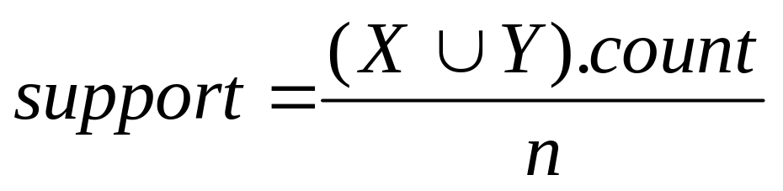
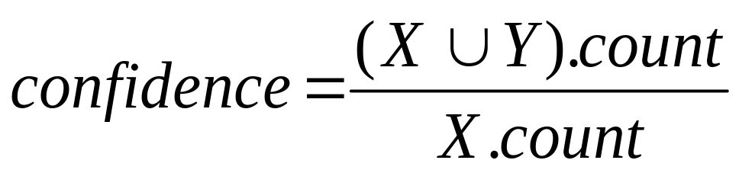
Support and Confidence
Support count: The support count of an itemset X, denoted by X.count, in a data set T is the number of transactions in T that contain X. Assume T has n transactions.
Then,
CS583, Bing Liu, UIC

Slide 9
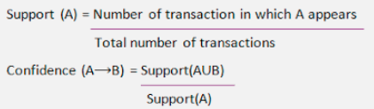
CS583, Bing Liu, UIC

Slide 10
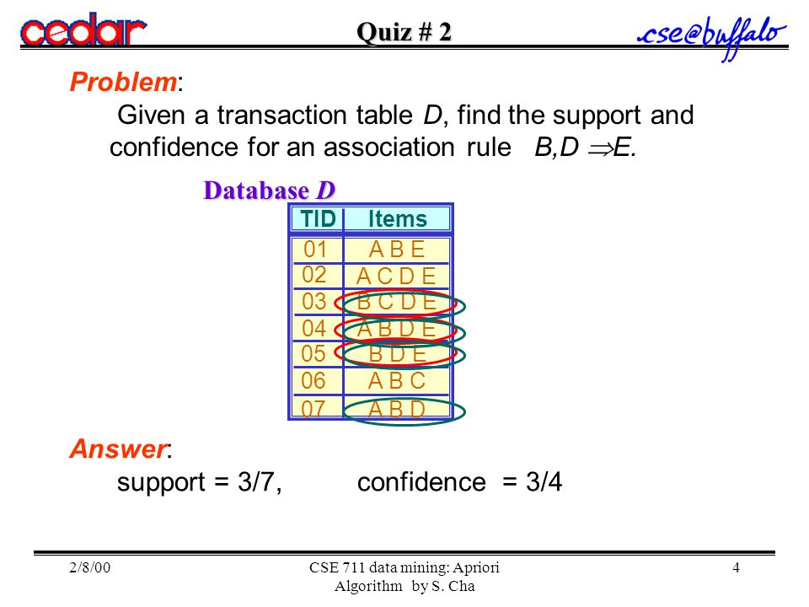
CS583, Bing Liu, UIC

Slide 11
An example
  t1: Beef, Chicken, Milk
  t2: Beef, Cheese
  t3: Cheese, Boots
  t4: Beef, Chicken, Cheese
  t5: Beef, Chicken, Clothes, Cheese, Milk
  t6: Chicken, Clothes, Milk
  t7: Chicken, Milk, Clothes
Transaction data
Assume:
minsup = 30%
minconf = 80%
An example frequent itemset:
{Chicken, Clothes, Milk} [sup = 3/7]
Association rules from the itemset:
Clothes → Milk, Chicken [sup = 3/7, conf = 3/3]
… …
Clothes, Chicken → Milk, [sup = 3/7, conf = 3/3]
CS583, Bing Liu, UIC

Slide 12
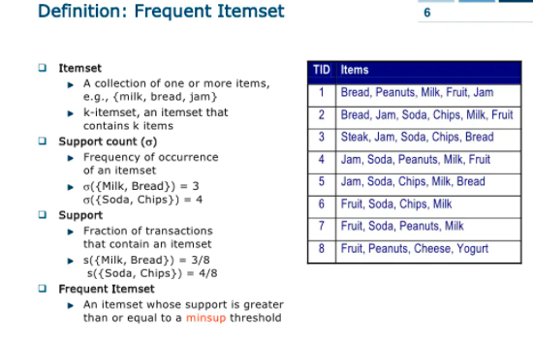
CS583, Bing Liu, UIC

Slide 13
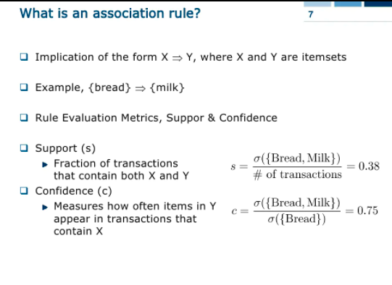
CS583, Bing Liu, UIC

Slide 14
Details: the algorithm
Algorithm Apriori(T)
C₁ ← init-pass(T);
F₁ ← {f | f ∈ C₁, f.count/n ≥ minsup}; // n: no. of transactions in T
for (k = 2; F_{k-1} ≠ ∅; k++) do
C_{k} ← candidate-gen(F_{k-1});
for each transaction t ∈ T do
for each candidate c ∈ C_{k} do
if c is contained in t then
c.count++;
end
end
F_{k} ← {c ∈ C_{k} | c.count/n ≥ minsup}
end
return F ← _{k} F_{k};
CS583, Bing Liu, UIC

Slide 15
Apriori candidate generation
The candidate-gen function takes F_{k-1} and returns a superset (called the candidates) of the set of all frequent k-itemsets. It has two steps
  join step: Generate all possible candidate itemsets C_{k} of length k
  prune step: Remove those candidates in C_{k} that cannot be frequent.
CS583, Bing Liu, UIC

Slide 16
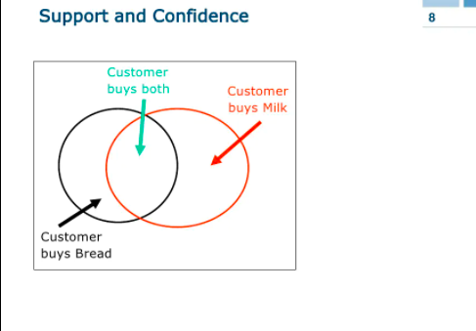
CS583, Bing Liu, UIC

Slide 17
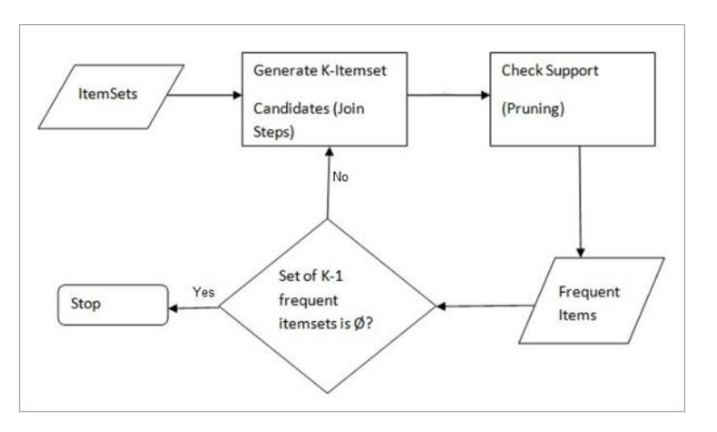
Apriori Frequent Itemset

Slide 18
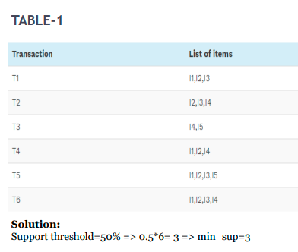
Example of Apriori: Support threshold=50%, Confidence= 60%

Slide 19
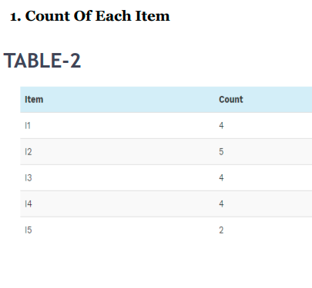

Slide 20
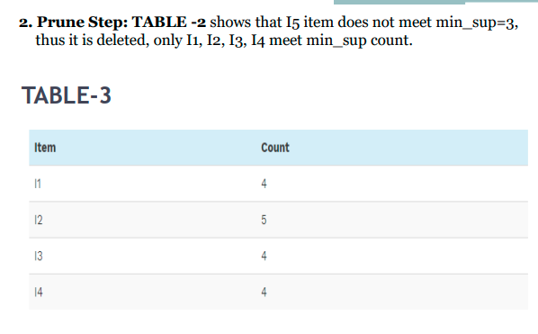

Slide 21
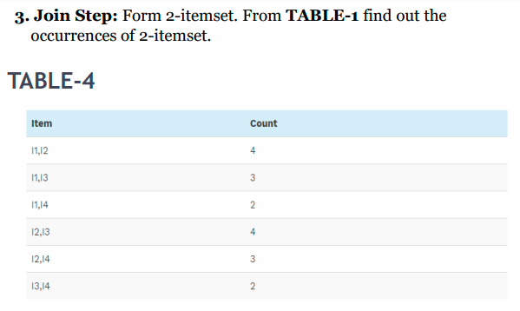

Slide 22
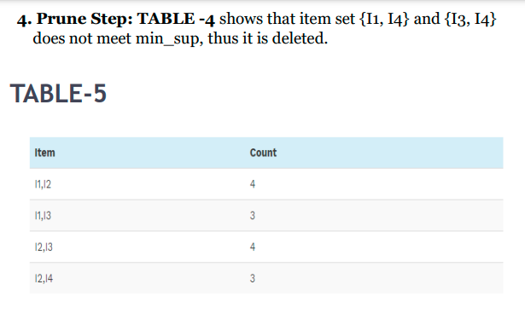

Slide 23
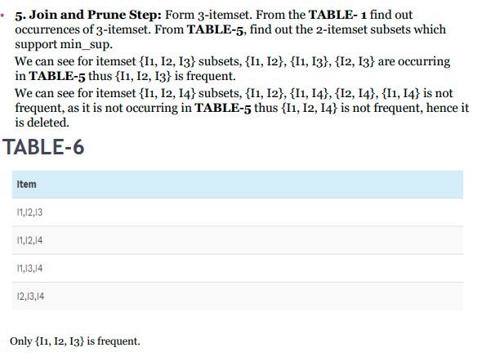

Slide 24
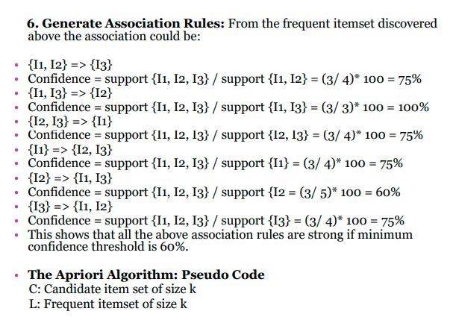

Slide 25
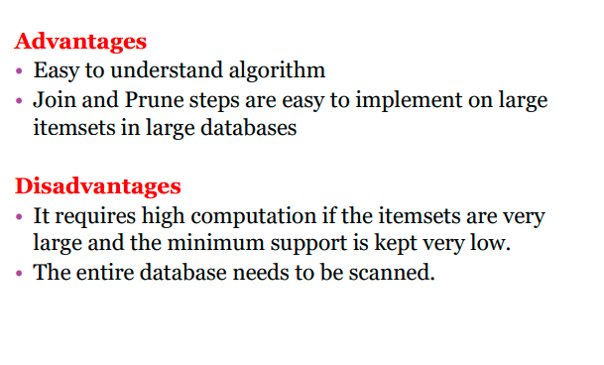

Slide 26
